Slide 1
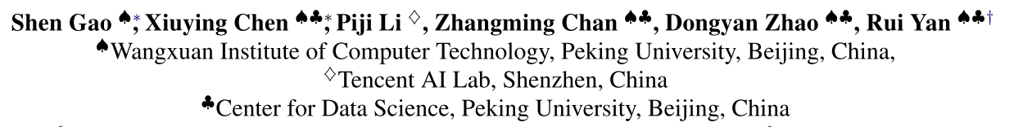
How to Write Summaries with Patterns ？ Learning towards Abstractive Summarization through Prototype Editing
EMNLP-2019
Liu Fang
2019-10-16

Slide 2
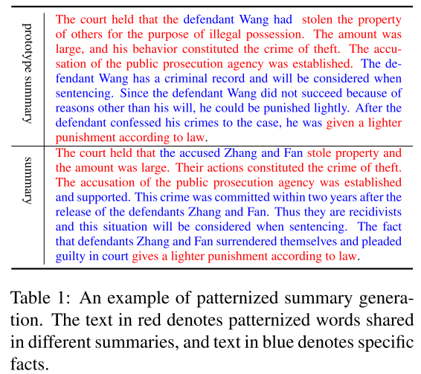
Introduction
Abstractive summarization has drawn significant attention since the introduction of deep neural networks to natural language processing.
Under special circumstances, the generated summaries are required to conform to a specific pattern, such as court judgments, diagnosis certificates, abstracts in academic papers, etc.
summary shares the same writing style and has words in common with the prototype summary (retrieved from the training dataset).
Notes:
法院判决，诊断证明

Slide 3
Introduction
Existing prototype based generation models such as (Wu et al., 2018) are all applied on short text, thus, cannot handle long documents summarization task.
Another series of works focus on template-based methods such as (Oya et al., 2014). However, template-based methods are too rigid for our patternized summary generation task.
Propose a summarization framework named Prototype Editing based Summary Generator (PESG) that incorporates prototype document-summary pairs to improve summarization performance when generating summaries with pattern.
Wu et al. 2018. Response generation by context-aware prototype editing. CoRR, abs/1806.07042.
Oya et al. 2014. A template-based abstractive meeting summarization: Leveraging summary and source text relationships. In INLG, pages 45–53
Notes:
基于模板的不够灵活

Slide 4
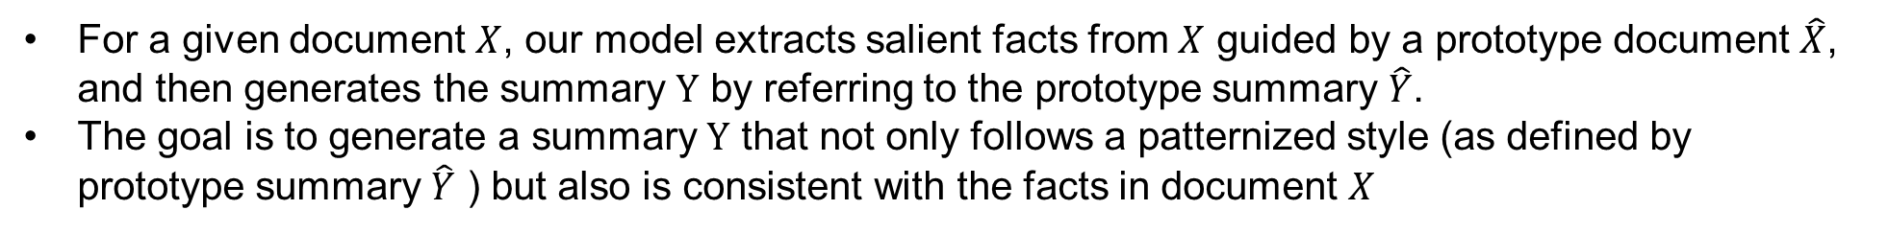
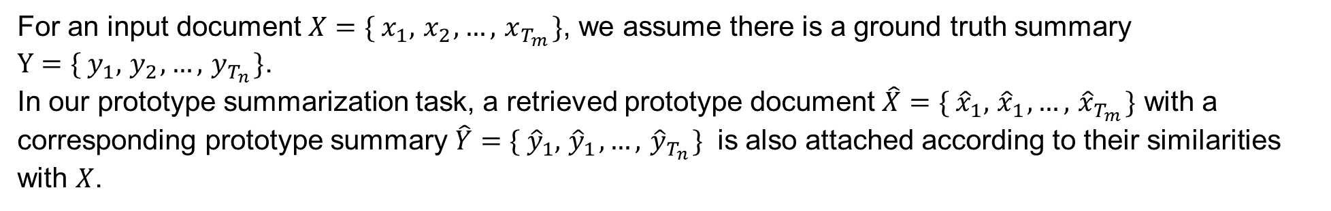
Problem Formulation
For an input document $X={\{ x}_{1},{ x}_{2},…,{ x}_{T_{m}}\}$, we assume there is a ground truth summary
$Y={\{ y}_{1},{ y}_{2},…,{ y}_{T_{n}}\}$.
In our prototype summarization task, a retrieved prototype document $\hat{X}=\{{ \hat{x}}_{1},{ \hat{x}}_{1},…,{ \hat{x}}_{T_{m}}\}$ with a corresponding prototype summary $\hat{Y}=\{{ \hat{y}}_{1},{ \hat{y}}_{1},…,{ \hat{y}}_{T_{n}}\}$ is also attached according to their similarities with $X$.
For a given document $X$, our model extracts salient facts from $X$ guided by a prototype document $\hat{X}$, and then generates the summary $Y$ by referring to the prototype summary $\hat{Y}$.
The goal is to generate a summary $Y$ that not only follows a patternized style (as defined by prototype summary $\hat{Y}$ ) but also is consistent with the facts in document $X$

Slide 5
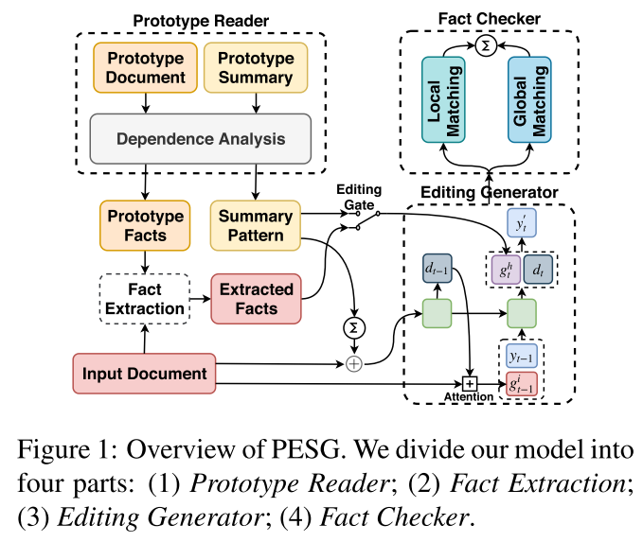
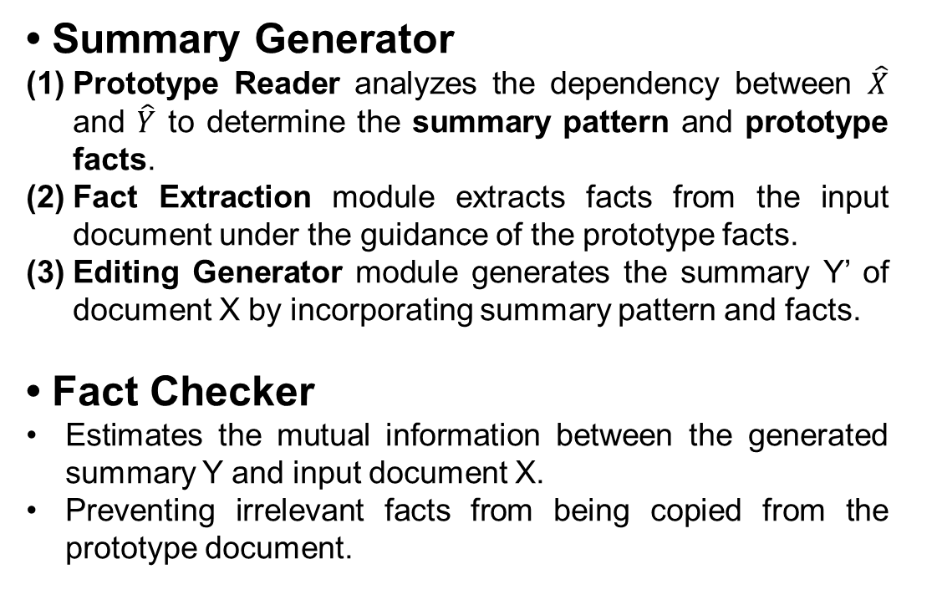
Model
• Summary Generator
Prototype Reader analyzes the dependency between $\hat{X}$ and $\hat{Y}$ to determine the summary pattern and prototype facts.
Fact Extraction module extracts facts from the input document under the guidance of the prototype facts.
Editing Generator module generates the summary Y’ of document X by incorporating summary pattern and facts.
• Fact Checker
Estimates the mutual information between the generated summary Y and input document X.
Preventing irrelevant facts from being copied from the prototype document.
Notes:
This information provides an additional signal for the generation process, preventing irrelevant facts from being copied from the prototype document.

Slide 6
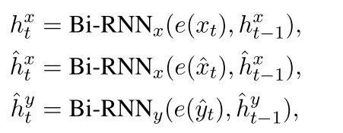

Model
Prototype Reader
Employ a bi-directional recurrent neural network (Bi-RNN) to model the temporal interactions between words:
Employ a bi-directional attention mechanism between a prototype document and summary to analyze the cross-dependency.
Notes:
the sections in the prototype summary that are not highly related to the prototype document are the universal patternized words and should be emphasized when generating the new summary.
the sections in the prototype document that are highly related to the prototype summary are useful facts that can guide the process of extracting facts from input document.

Slide 7





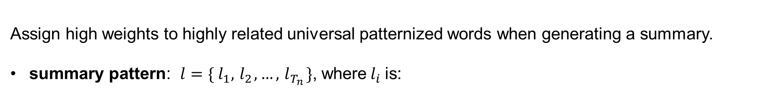
Model
Prototype Reader
represent the attention weight on the t-th prototype summary word by document
Assign high weights to highly related universal patternized words when generating a summary.
summary pattern: $l={\{ l}_{1},{ l}_{2},…,{ l}_{T_{n}}\}$, where${ l}_{i}$is:
assigns high weights to the words in a prototype document that are relevant
to the prototype summary.
prototype facts:
Overall representation of these facts:
Notes:
Attention矩阵对应列求平均
Pattern从summary中提取，fact从document中提取

Slide 8



Model
Fact Extraction
Extract the facts from an input document by calculating their relevance to prototype facts.
Then, we sum up Eij along the length of the prototype document to obtain the weight
for j-th word in the document.
a convolutional layer is applied on the weighted hidden states to obtain the fact representation rt from the input document:

Slide 9
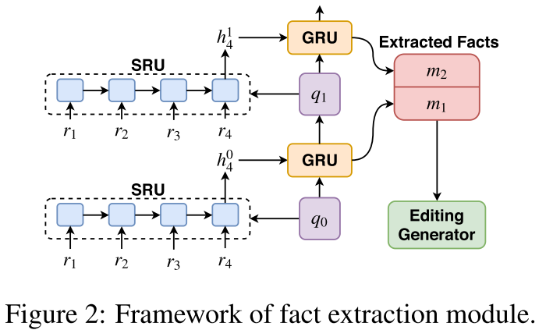



Model
Fact Extraction
Then use the prototype facts to polish the extracted facts rt and obtain the final fact representation m.
Two hierarchical recurrent layers：
Selective Recurrent Units (SRUs): take facts r. and polished fact qk as input, outputting the hidden state
Gated Recurrent Units (GRUs): update the polished fact from qk to qk+1 using
This iterative process is conducted K times, and each output mk is stored as extracted facts M = {m1,m2, . . . ,mK}. M stores facts with different polished levels.
Notes:
q: prototype facts

Slide 10




Model
Editing Generator
Aims to generate a summary based on the input document, prototype summary and extracted facts.
First apply a linear transformation on the summation of the summary pattern
and input document representations
Then employ this vector as the initial state d0 of the RNN generator:
: context vector produced by the standard attention mechanism

Slide 11
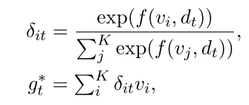

Model
Editing Generator
To take advantage of the extracted facts M and prototype summary pattern l, we incorporate them both into summary generation using a dynamic attention.
Matching function f: model the relationship between the current decoding state dt and each vi (vi can be a extracted fact mi or summary pattern li)
where $g_{t}^{∗}$ can be $g_{t}^{m}$ or $g_{t}^{s}$ for attending to extracted facts or a summary pattern.
“editing gate”$γ$: combining $g_{t}^{m}$ and $g_{t}^{s}$:
Notes:
重新计算attention：考虑m和l
$γ$ is determined by the decoder state $d_{t}$, to decide the importance of the summary pattern and extracted facts at each decoding step.

Slide 12


Model
Editing Generator
$g_{t}^{h}$: dynamically combines information from the extracted facts and summary pattern with the editing gate$γ$：
Finally, the context vector $g_{t}^{h}$ is concatenated with the decoder state $d_{t}$ and fed into a linear layer to obtain the generated word distribution $P_{v}$
In order to handle the out-of-vocabulary (OOV) problem, we equip our decoder with a pointer network.

Slide 13




Model
Fact Checker
Generate accurate summaries that are consistent with the detailed facts from the input document rather than facts from the prototype document.
Neural Mutual Information Estimator: estimate the mutual information between the generated summary Y and its corresponding document X, as well as the prototype document $\hat{X}$ .
local features of input extracted facts and the prototype facts:
A 1 × 1 convolutional layer and a fully-connected layer are applied to score these two features:
Make the generated summary to be more similar to the input document than the prototype document. optimization objective of the local matching network: minimize
Notes:
where τr ∈ R, τf ∈ R represent the local matching degree between the generated summary and input document and prototype document

Slide 14



Model
Fact Checker
global features between the generated summary and the input document, as well as prototype document:
The objective of this global matching network, similar to the local matching network, is to minimize:
Combine the local and global loss functions to obtain the final loss L:
Notes:
dTn: final hidden state of the generator RNN

Slide 15
Experimental Setup
Dataset
A large-scale prototype based summarization dataset: contains 2,003,390 court judgment documents.
Use a case description as an input document and the court judgment as the summary.
Average lengths of the input documents and summaries are 595.15 words and 273.57 words respectively.
The percentage of words common to a prototype summary and the reference summary: 80.66%.
Anonymize entity tokens into special tags, such as using “PERS” to replace a person’s name.
Comparisons
Lead-3: selects the first three sentences of document as the summary
S2S: a sequence-to-sequence framework with a pointer network
Proto: a context-aware prototype editing dialog response generation model
Re3Sum: uses an IR platform to retrieve proper summaries and extends the seq2seq framework to jointly conduct template-aware summary generation
Uni-model: the current state-of-the-art abstractive summarization approach on the CNN/DailyMail dataset
Concat-S2S and Concat-Uni: directly concatenate the prototype summary with the orig- inal document as input for S2S and Uni-model

Slide 16
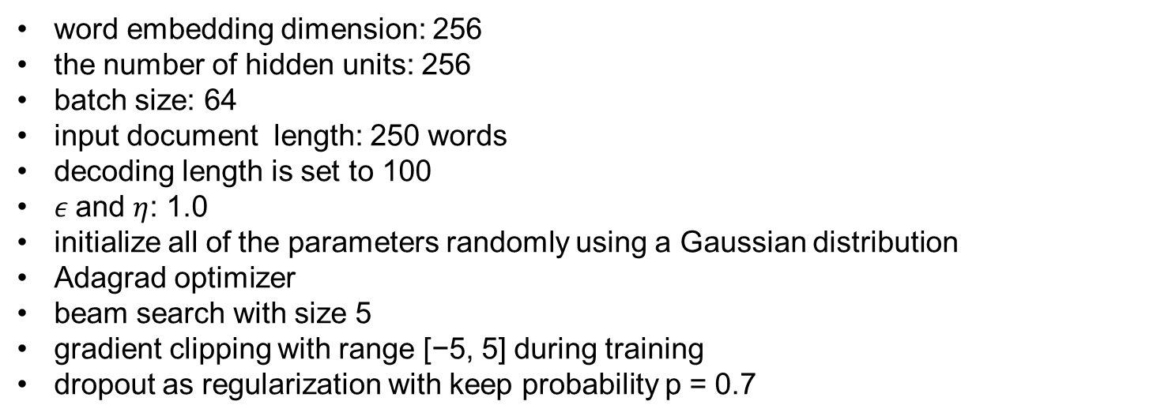
Experimental Setup
Evaluation Metrics
ROUGE-1, ROUGE-2 and ROUGE- L
human evaluation
Implementation Details
word embedding dimension: 256
the number of hidden units: 256
batch size: 64
input document length: 250 words
decoding length is set to 100
$ε$and $η$: 1.0
initialize all of the parameters randomly using a Gaussian distribution
Adagrad optimizer
beam search with size 5
gradient clipping with range [−5, 5] during training
dropout as regularization with keep probability p = 0.7

Slide 17
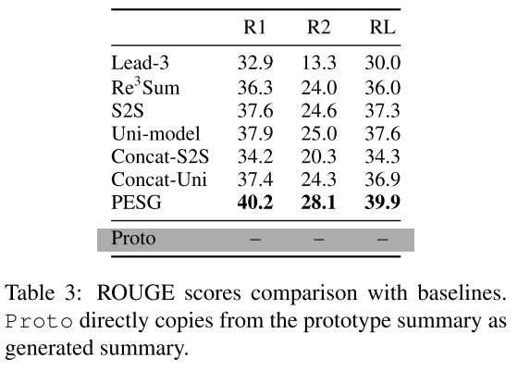
Experimental Result
Overall Performance
Our model performs consistently better than other summarization models including the state-of-the-art model.
Directly concatenating the prototype summary with the original input does not increase performance, instead leading to drops.
As for the baseline model Proto, we found that it directly copies from the prototype summary as generated summary, which leads to a totally useless and incorrect summary.

Slide 18
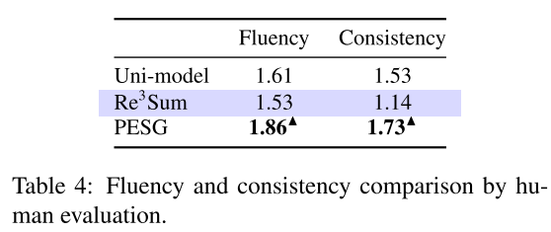
Experimental Result
Overall Performance
For the human evaluation, we asked annotators to rate each summary according to its consistency and fluency.
The rating score ranges from 1 to 3, with 3 being the best.

Slide 19
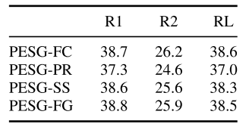
Experimental Result
Ablation Study

Slide 20
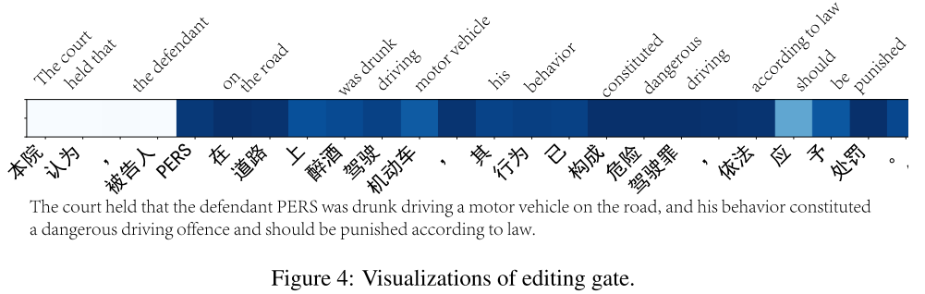
Experimental Result
Analysis of Editing Generator
A lower weight (lighter color) means that the word is more likely to be copied from the summary pattern

Slide 21
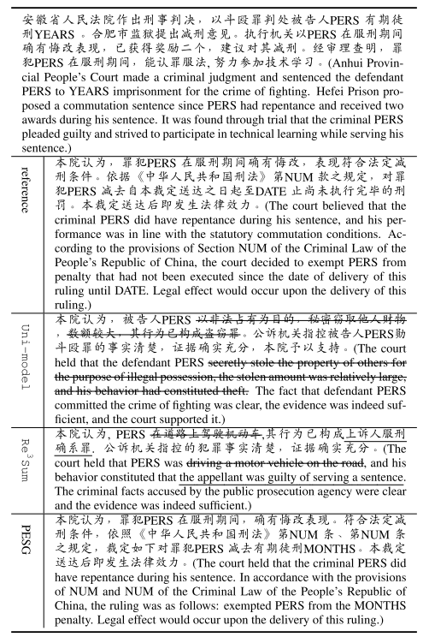
Experimental Result
Analysis of Editing Generator
the summary generated by Uni-model faces an inconsistency problem
the summary generated by Re3Sum is contrary to the facts described in the input document
PESG overcomes both of these problems and generates an accurate summary with good grammar and logic.

Slide 22
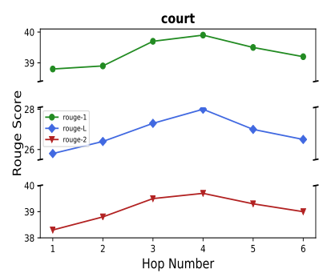
Experimental Result
Analysis of Fact Extraction Module
investigate the influence of the iteration number when facts are extracted.

Slide 23
Thanks

